Slide 1
DEEP LEARNING PROJECT
Ángela María Arias
Raúl Andrés Pardo Moreno
July 2018

Slide 2

STEP BY STEP
PREDICTORS
MODELS
RESULTS
Machine Learning
R.F.
CNN
INPUT
[0,2,5..]
INPUT
[..3,0,23…]
[6,0,0..]
[88,2,0,3..]
PREDICTIONS
Images
PREDICTIONS
Comedy

Slide 3
Images
Gradient Boosting
Convolutional Neural Network
Recurrent Neural Network
Our models:

Slide 4
Text
Random Forest Classifier
Convolutional Neural Network
Transfer Learning
Our models:

Slide 5
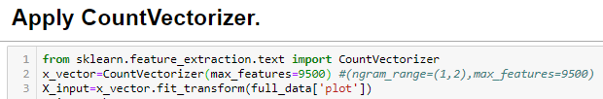
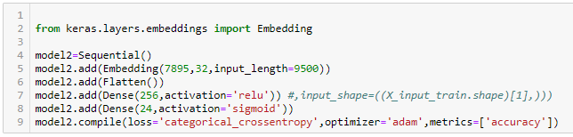
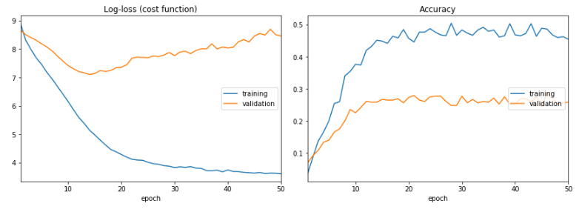
The results:
T
E
X
T

